Slide 1

ME 515 Course Project
2025
Design and Development of an Anthropomorphic
Soft Hand Exoskeleton
Date: 05 May 2025
Subhash Pratap
186103034
Ritwik Jain
244103208
Vakkanthula Phanidhar
244103224
Raagdeep Raj
196103023
Himakshi Baishya
226103104
Department of Mechanical Engineering
Indian Institute of Technology Guwahati
Notes:
We are pleased to present our ME 515 course project for the year 2025, titled "Design and Development of an Anthropomorphic Soft Hand Exoskeleton."
This project was carried out by our team:
Subhash Pratap (ID: 186103034)
Ritwik Jain (ID: 244103208)
Vakanthula Phanidhar (ID: 244103224)
Raagdeep Raj (ID: 196103023)
Himakshi Baishya (ID: 226103104)
We are all students from the Department of Mechanical Engineering at the Indian Institute of Technology Guwahati.
The date of submission for this project is 5th May 2025.
In this project, we focused on developing a soft exoskeleton for the human hand, designed to mimic the natural movements and dexterity of a real hand. Our aim was to create a device that is not only functional and adaptive but also comfortable for the user, with potential applications in rehabilitation, assistive technology, and robotics.
We look forward to sharing the details of our design process, development challenges, and the results of our prototype testing in the following slides.

Slide 2
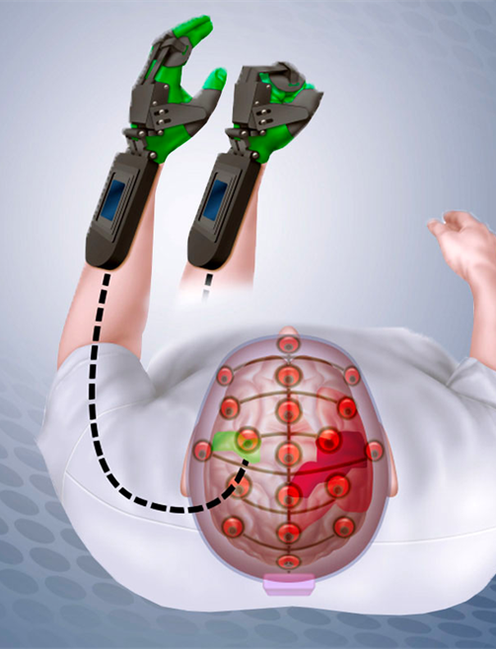
Motivation and Application
Motivation | Application
Hand impairments limit daily activities due to neurological, spinal, or musculoskeletal conditions. 2. Limitations of current solutions: Traditional rehab: labour-intensive, lacks objective tracking. Assistive devices: often unnatural, non-adaptive. | 1. Rehabilitation: repetitive, controlled motion, objective assessment. 2. Assistive use: improved grip/dexterity for permanent impairments. 3. Industrial use: reduces fatigue/injuries in repetitive tasks. 4. Research: enables studies in motor control and prosthetics.

Slide 3
Originality beyond Lab Experiments
Path to real-world use: Prototype fabrication, experimental validation, sensor and AI integration.
Simulation-driven optimization: Advanced CAD and FEA based on SOLIDWORKS.
Soft robotics approach: Flexible, lightweight, tendon-driven-overcomes bulk/discomfort of rigid exoskeletons.
Biomimetic, user-centric design: Anatomically accurate, comfortable, and kinematically compatible.

Slide 4
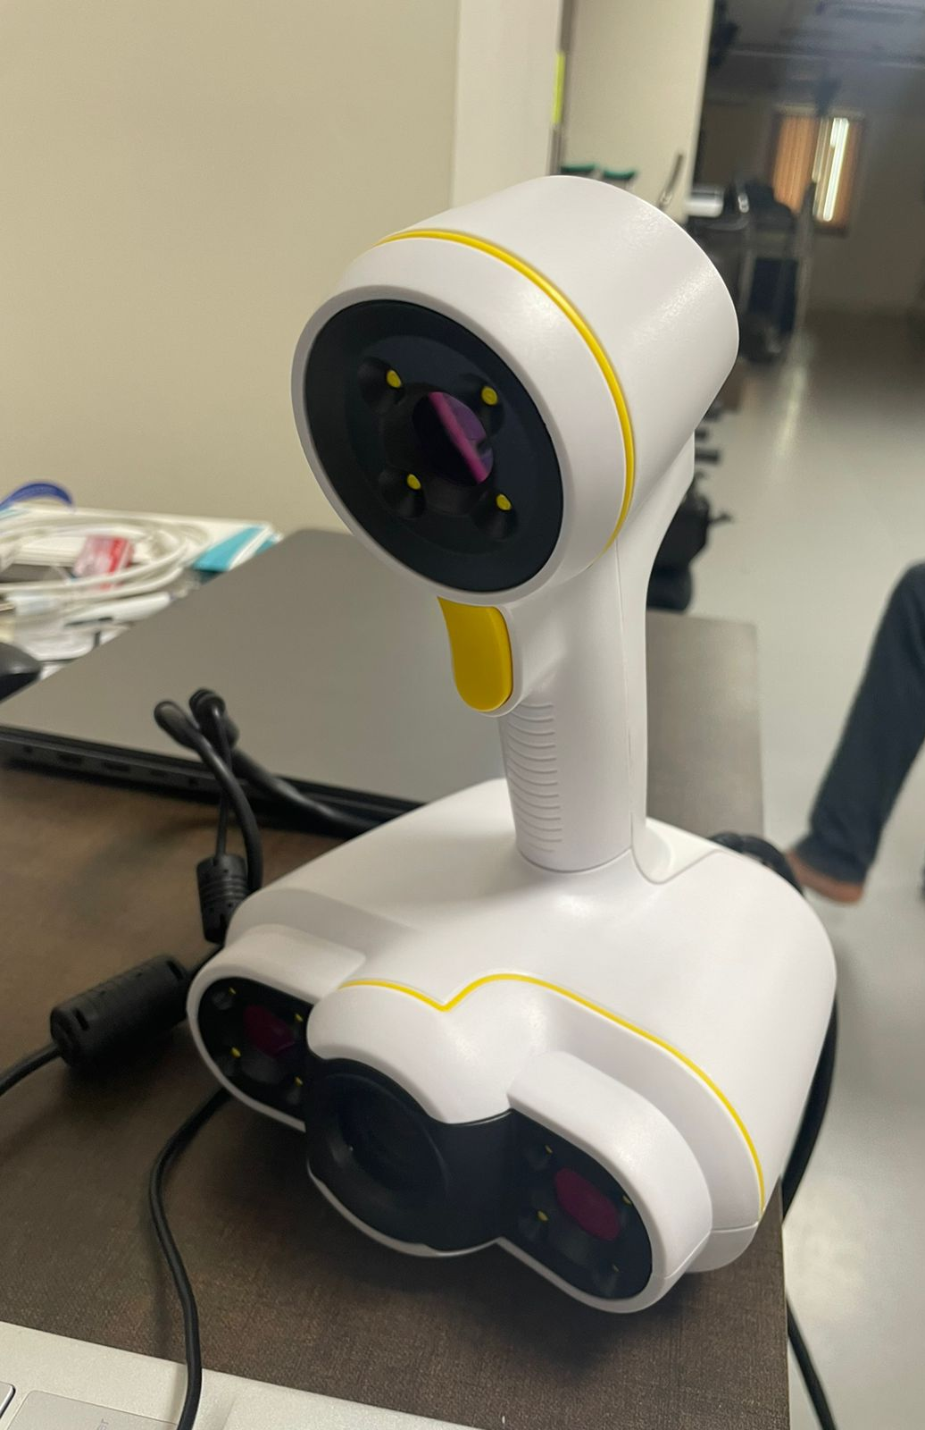
Introduction to 3D Scanning in the Project
Objective: To capture an accurate 3D model of a subject's hand for designing a personalized exoskeletal brace.
Technology Used: Peel 3D – Peel2 handheld scanner – suitable for precise anatomical scanning.
Obtain accurate geometry of the hand in a relaxed position.
Serve as a reference for brace design, ensuring comfort, functionality, and fit.
Specification | peel 2
Accuracy | Up to 0.250 mm (0.01 in.)
Measurement resolution | Up to 0.250 mm
Scanning area | 380 x 380 mm (15.0 x 15.0 in.)
Fig.1: Peel 3D Handheld Scanner

Slide 5
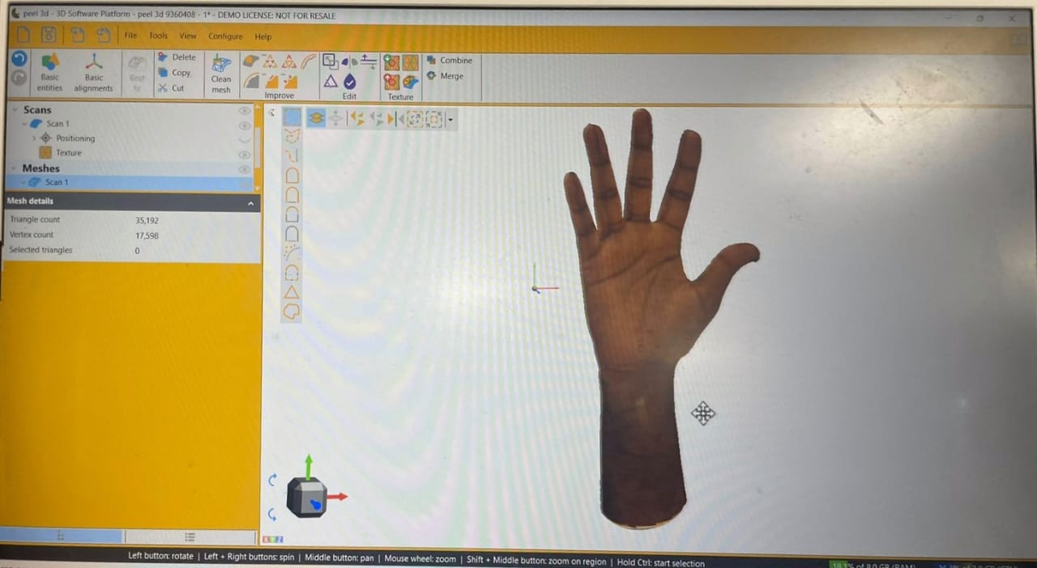
3D Scanning Process
Subject seated comfortably with hand stabilized.
Neutral hand pose maintained for consistency.
Preparation of Subject:
Peel 3D scanner calibrated using included targets.
Reference markers were placed directly on the subject’s hand and the scanning platform to assist with precise tracking and alignment.
Controlled lighting environment to minimize noise.
Scanning Setup:
Scanning Execution:
Full 360° scan of the hand captured.
Real-time alignment and mesh generation in Peel 3D software.
Fig.2: Peel 3D Scanning Interface

Slide 6
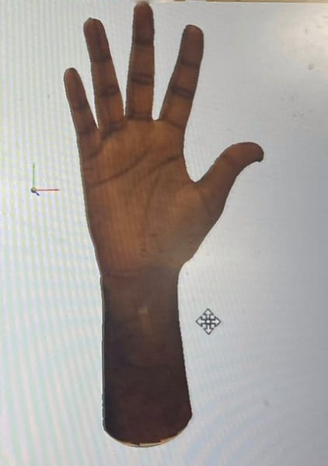
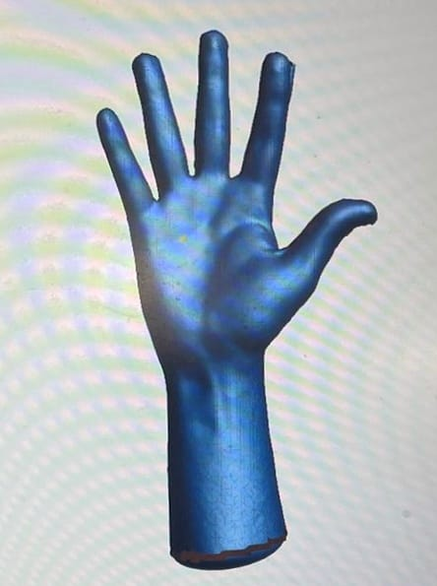
Post-Processing the Scan
Post-Processing the Scan: Cleaning and Prepare the 3D Model
Software Used: Peel 3D software suite for post-processing.
Mesh Clean-up Removed noise, holes, and artefacts.
Alignment
Ensured hand was oriented along standard axes.
Scaling & Unit Checking
Verified accurate real-world dimensions.
Fig.3 : Before-and-after image of the scanned mesh.

Slide 7
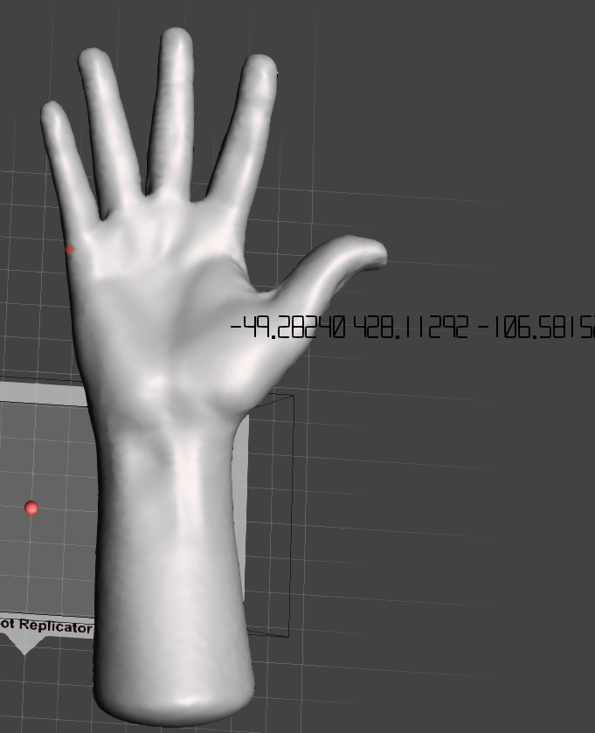
Parameter Extraction from the 3D Model
Tools Used: Autodesk Meshmixer
Palm Width & Length
12 cm
11 cm
11 cm
11 cm
Finger Lengths (index, middle, ring, pinky, thumb)
4.2cm
9 cm
3 cm
9.5 cm
Joint Positions (knuckles, interphalangeal joints)
5 cm
13 cm
Curvature and Contour Data for brace fit
5 cm
5.2 cm
Fig. 4: Parameter Measurement from STL file
Fig. 5: Hand Parameters

Slide 8
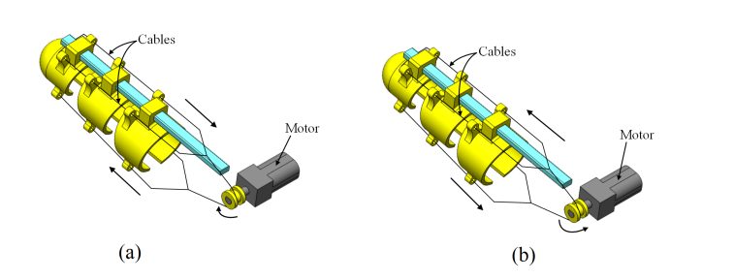
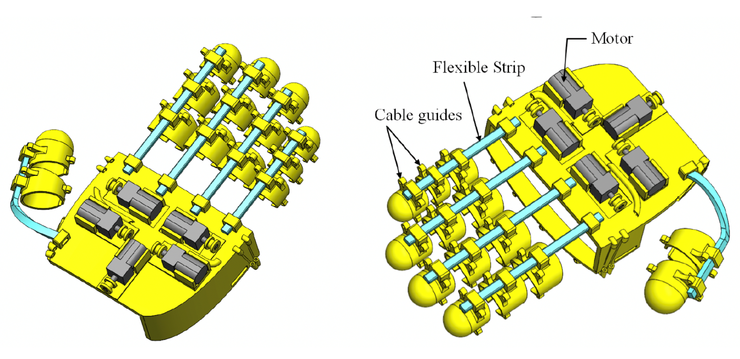
Detailed Computer Aided Design
Compactness and Size Flexibility:
Conventional exoskeletons lack compactness and restrict hand size.
Proposed design accommodates various hand sizes and shapes.
Utilizes open half-glove design and modular finger units for versatility.
Tendon-Driven Cable Actuation:
Tendon system operated by cables chosen for actuation.
Single actuator controls all joint movements of finger.
Cables and single motor enable flexion and extension using bidirectional approach
Structural Integrity and Material Selection:
Finite Element Analysis (FEA) ensures structural integrity.
Suitable materials selected for durability and force requirements.
Cable guides incorporated for efficient finger movement.

Slide 9
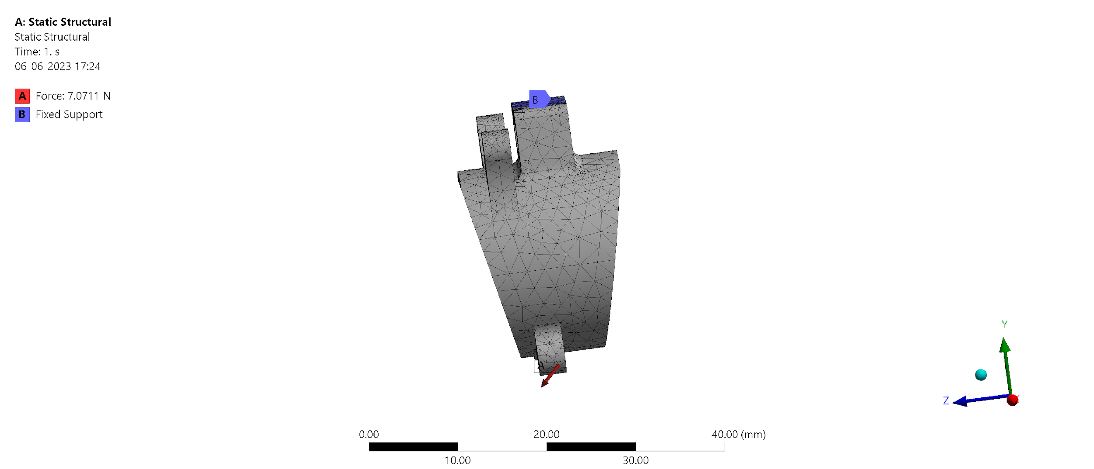
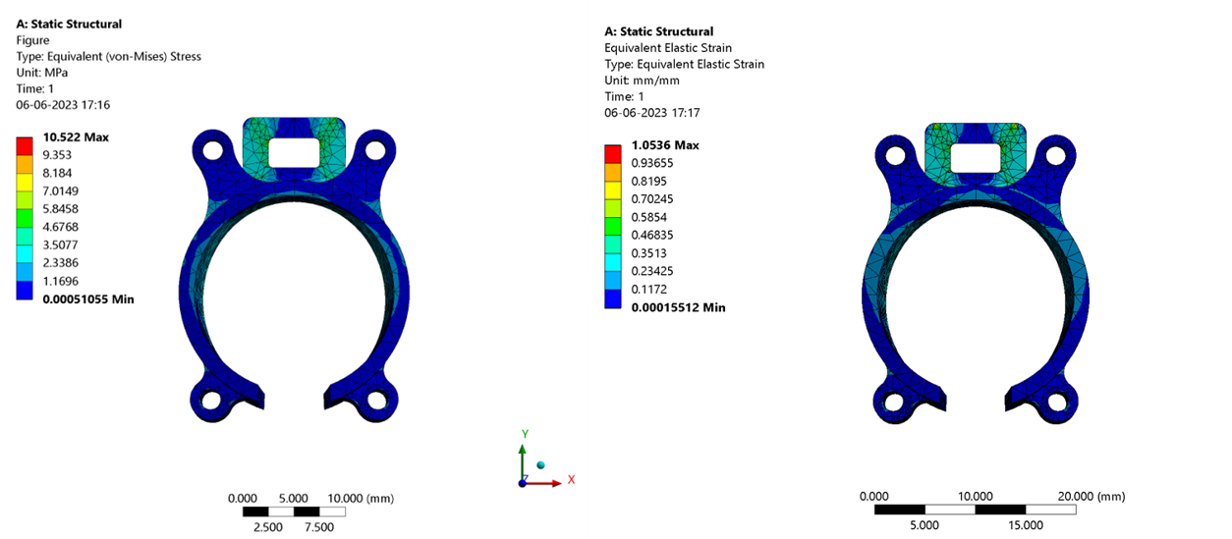
Design and Analysis Iterations
Finite element analysis (FEA) conducted on annular ring under physiological loads.
Qualitative assessment of structural integrity
Worst-case scenario considered with doubled force values.
Components subjected to forces via cables.
Structural strength and flexibility are analyzed to optimize material selection and joint design, minimizing weight and maximizing durability.
Elastic deformations observed but within acceptable limits.
Three materials considered: ABS, PLA, and TPU.
TPU material exhibited higher maximum stress but within allowable strain range.
ABS and PLA showed slight deformation due to finger flexion.

Slide 10






Detailed Manufacturing Plan with Cost and Time
Material selection: Soft elastomers (TPU) for comfort; stiffer polymers (PLA, ABS) for support.
3-D printing: Rapid, modular fabrication.
Assembly: Tendons, actuators, adjustable straps; modular for easy maintenance.
Cost: 4500 INR- 3D Printing material filaments
Timeframe: 2–4 weeks from design to prototype.
Scalability: Supports small-batch or custom production.

Slide 11
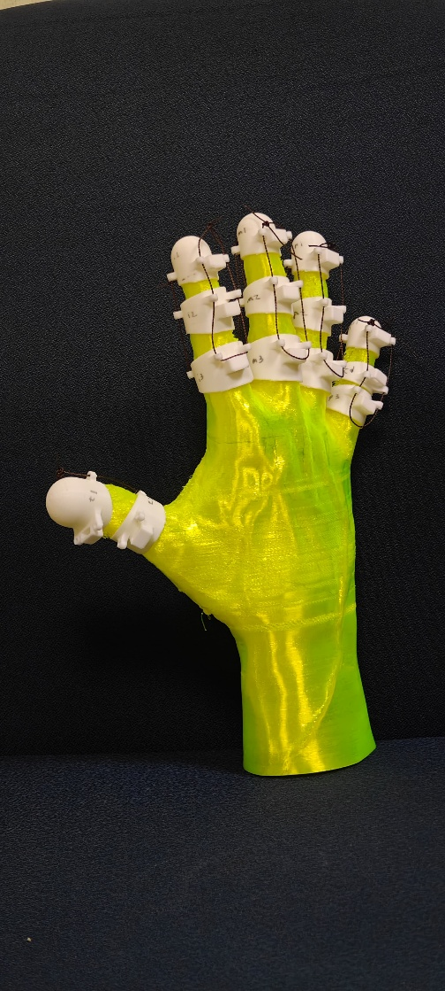


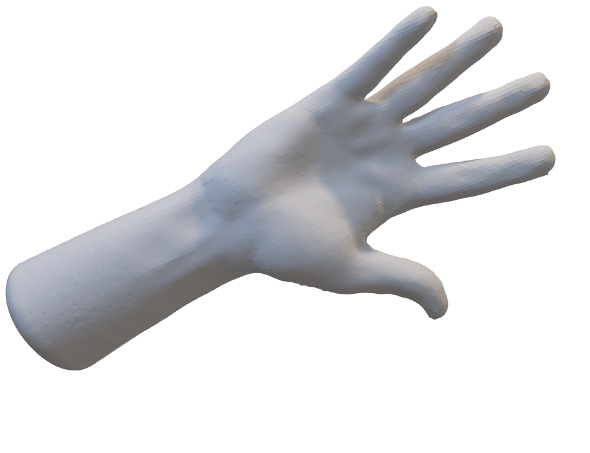

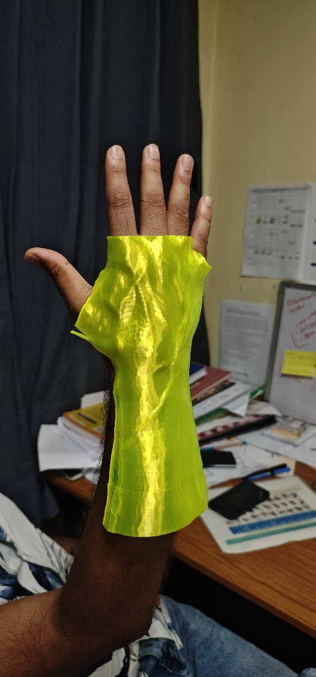
Fabrication Details
Component printing: 3-D printed for strength and accuracy.
Post-processing: Cleaning, smoothing, dimensional checks.
Tendon/actuator integration: Routed and calibrated for precise movement.
Final assembly: Fasteners, adhesives, adjustable straps.
Testing/validation: Range of motion, force, comfort, durability.

Slide 12
Conclusions
Ergonomic, biomimetic design: Comfort, adaptability, natural movement.
Simulation-driven optimisation: Robust, reliable performance.
Practical fabrication: Rapid prototyping, easy customization.
Real-world readiness: Foundation for sensor integration, AI control, clinical use.

Slide 13
References
Pratap, Subhash, et al. "Restoring Human Grasp Functionality Through Soft Hand Exoskeletons." Intelligent Cyber-Physical Systems for Healthcare Solutions. Springer, Singapore, 2024. 195-216.
Pan, Mingzhang, Yingzhe Tang, and Hongqi Li. "State-of-the-art in data gloves: A review of hardware, algorithms, and applications." IEEE Transactions on Instrumentation and Measurement 72 (2023): 1-15.
Shahid, Talha, et al. "Moving toward soft robotics: A decade review of the design of hand exoskeletons." Biomimetics 3.3 (2018): 17.
Tran, Phillip, et al. "Hand exoskeleton systems, clinical rehabilitation practices, and future prospects." IEEE Transactions on Medical Robotics and Bionics 3.3 (2021): 606-622.
Pratap, Subhash, et al. "Robust Non-Singular Terminal Sliding Mode Control for Tendon-driven Hand Exoskeleton: A Numerical Study." 2024 10th International Conference on Control, Decision and Information Technologies (CoDIT). IEEE, 2024.
Pratap, Subhash, et al. "Design and Control of Tendon-Driven Soft Hand Exoskeleton: A Preliminary Study." 10th IEEJ International workshop on Sensing, Actuation, Motion Control, and Optimization (SAMCON2024). IEEJ, 2024.

Slide 14
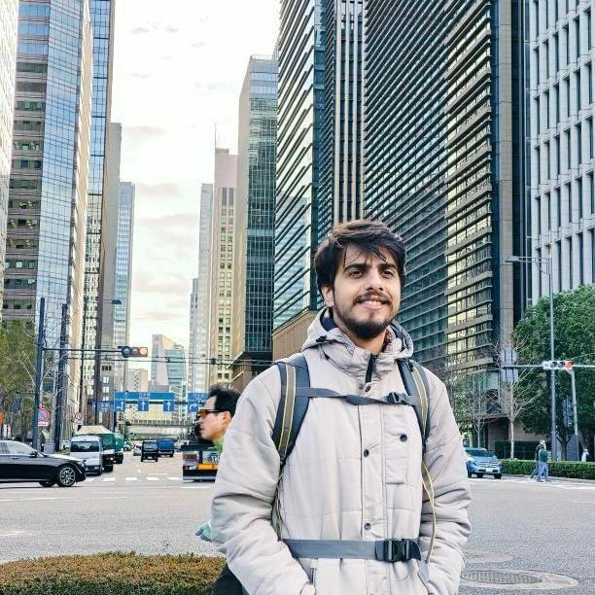
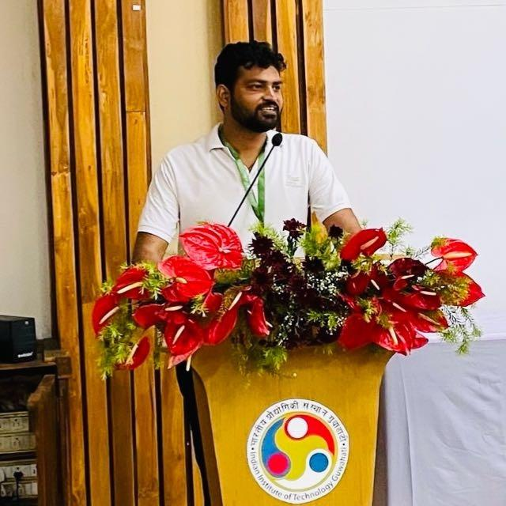



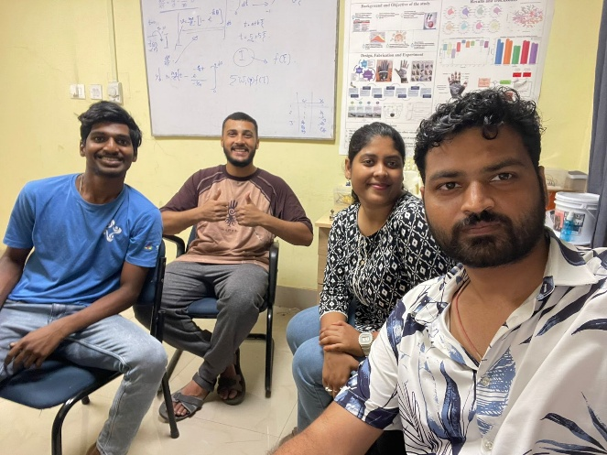
Raagdeep Raj
196103023
Subhash Pratap
186103034
Himakshi Baishya
226103104
Vakkanthula Phanidhar
244103224
Ritwik Jain
244103208
Thank You

